Slide 1

ENGIE Lab CRIGEN
Valentin Gavan | ENGIE Lab CRIGEN, France

Slide 2
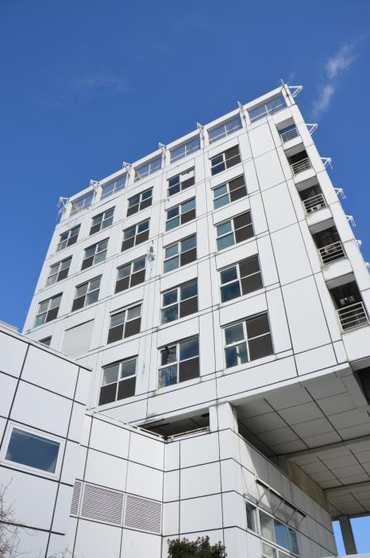
ENGIE Lab CRIGEN, Paris, France
Within the R&T Division, Engie Lab CRIGEN is the R&D center dedicated to gas chain, new energies and new technologies
Providing tried, tested and market ready industrial applications and new commercial offers
Improve Operational Performance, Asset Management
Develop Innovative Low Carbon Energy Solutions
Integrate New Technologies
LNG chain, LNG behavior
Gas, heating and cooling networks
Gas quality, gas metering
Industrial risk management
Energy systems for buildings
Fuel cells
Energy efficiency in industry
Biogas, biomethane, power-to-gas
Distributed energy generation and storage.
Nanotechnologies
Digital Solutions, Big Data
Smart technologies
Industrial drones
Life cycle analysis
€72 million revenue, from
30 countries
175 employees
Unique Testing Facilities in Europe – some accredited
An international ecosystem of R&D and Innovation Partners

Slide 3
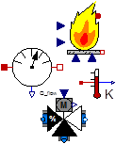
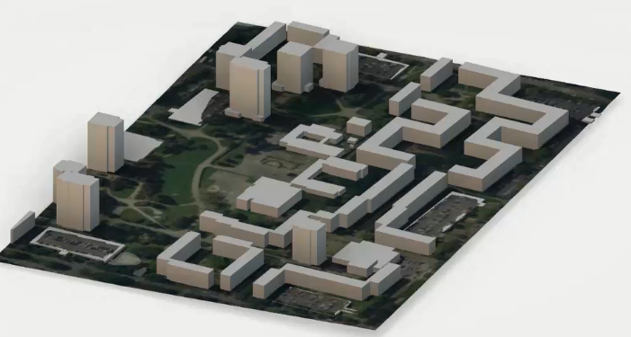
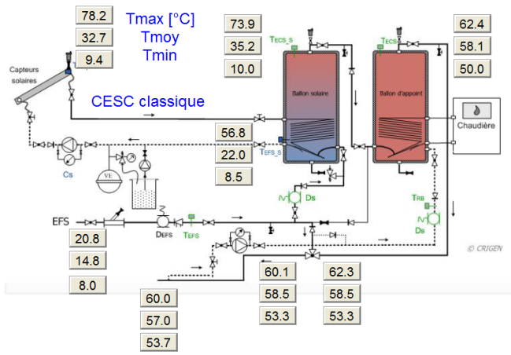
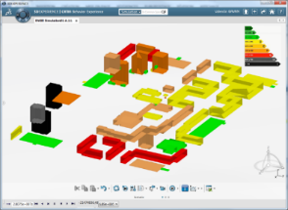
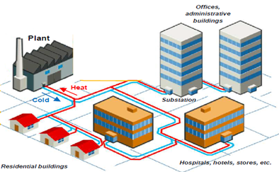
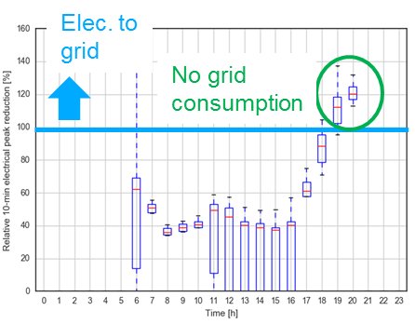

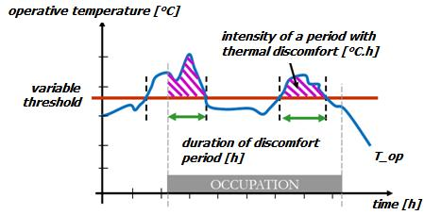
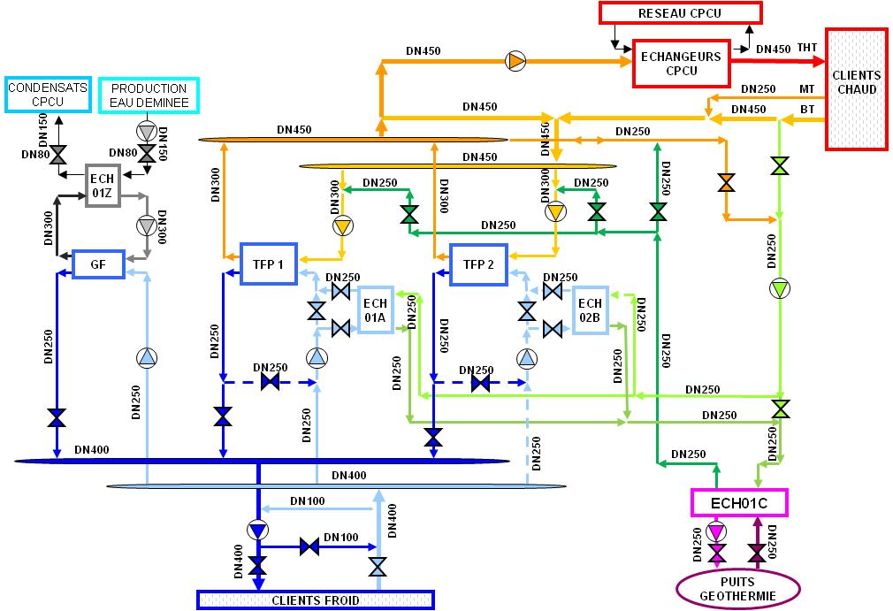
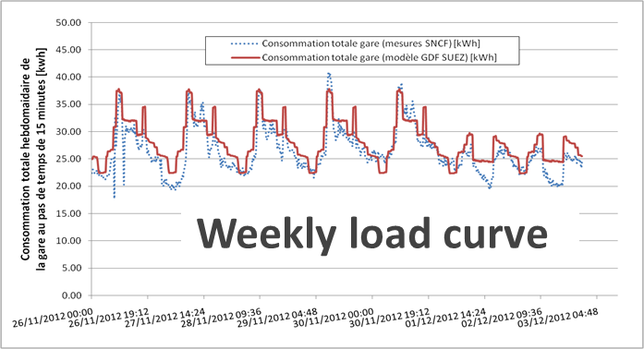
ENGIE Lab CRIGEN, Paris, France
Component
Building
Building stock
District & City
Planning & roadmap for cities
Scale
Envelop & Equipment
optimization
3D modeling + behavior
…
Planning & Early design
0.5-3 Years
5% Costs
Engineering
Available Data
(BMS + IoT+ other)
1-4 Years
20% Costs
City scale “What if” Scenarios
Construction
Forecast & control
Impact to grid
Network design
O&M
Gamification
App
20-30 Years
75% Costs
“Flight simulator” for plant operators
Indoor environment analysis
End-user solutions
Intrusive analysis
Data Driven Optimized Operations
Use

Slide 4
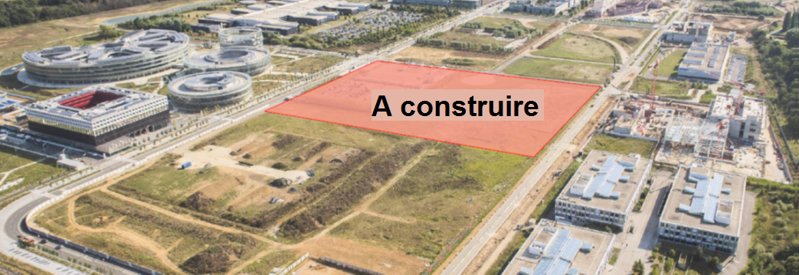
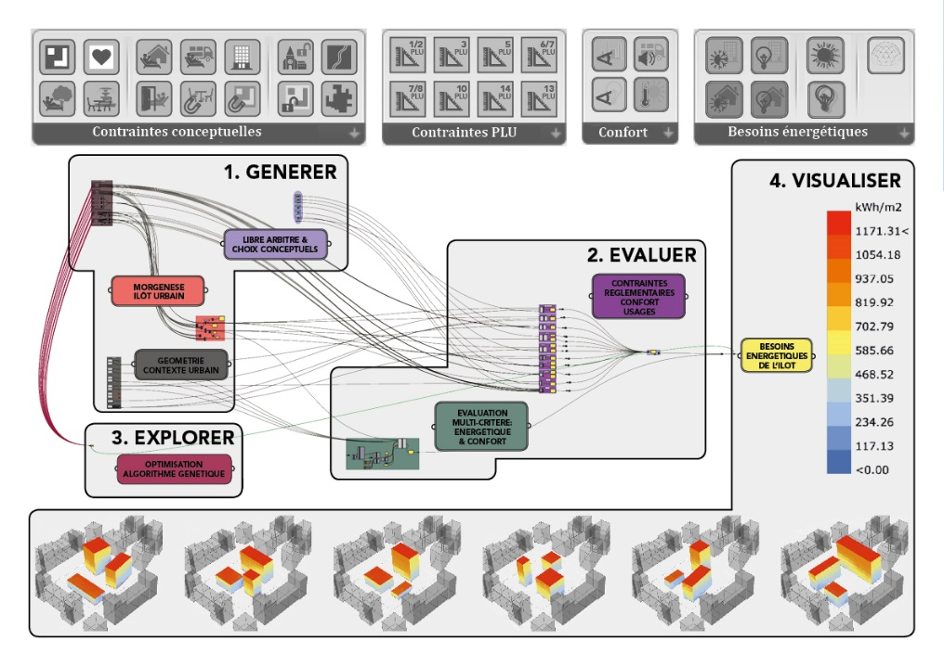
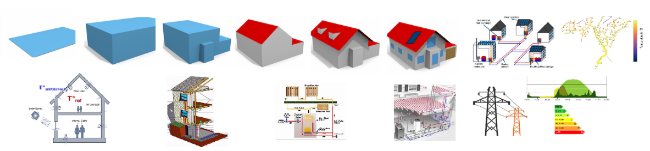
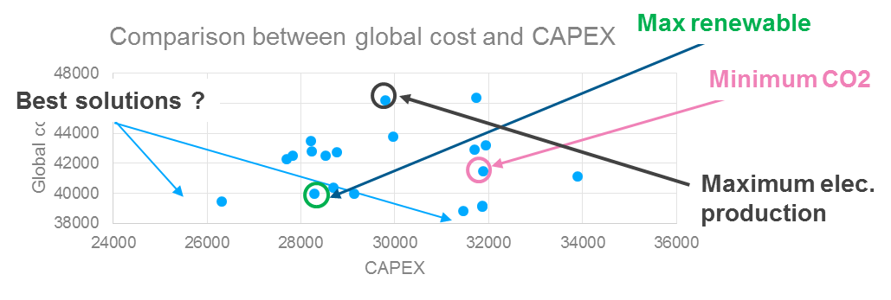



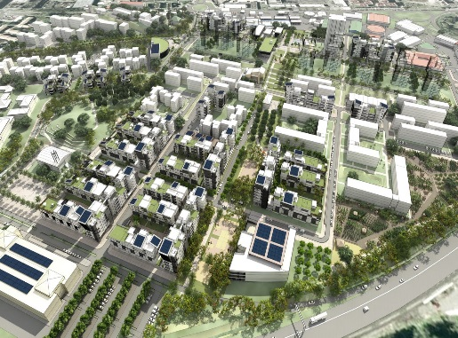
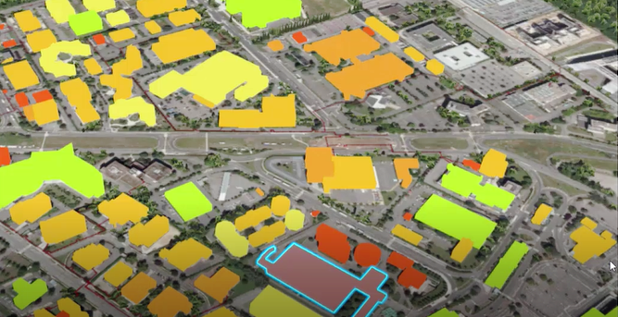
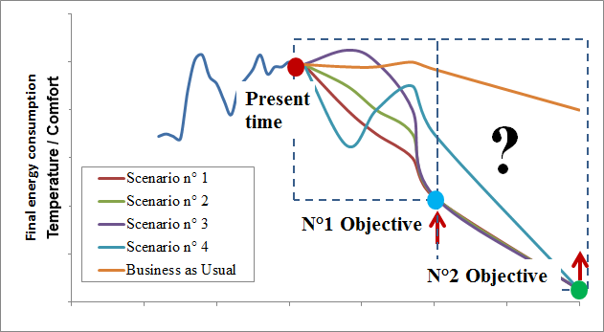
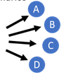


Why using tools at early stage for real estate projects ?
Real estate project
Tools and expertise needed
Greenfield
Existing
Actions
Feasibility phase
Conceptual design phase
Tenders
Permitting phase
Detailed Design
Construction phase
O&M phase

Slide 5

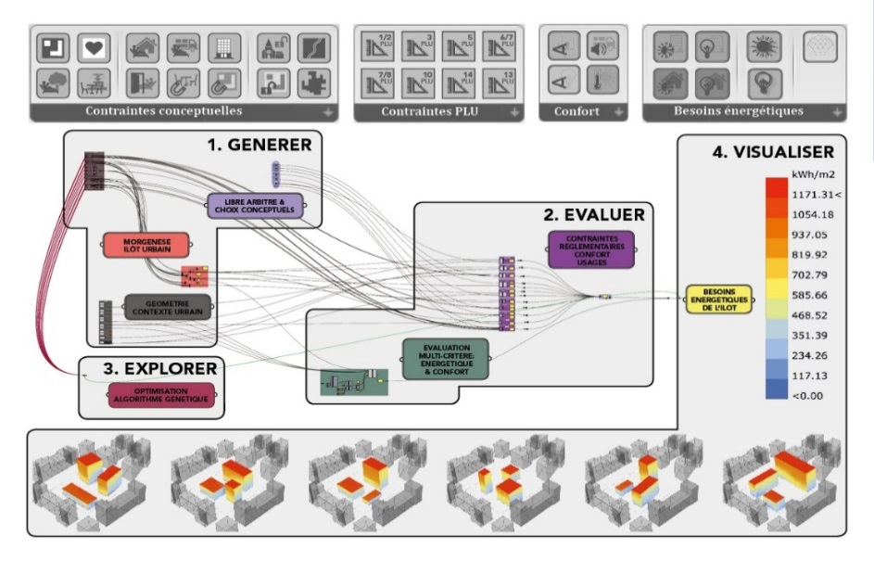
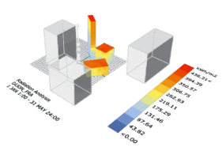
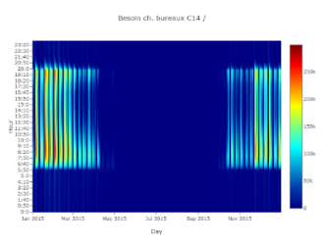
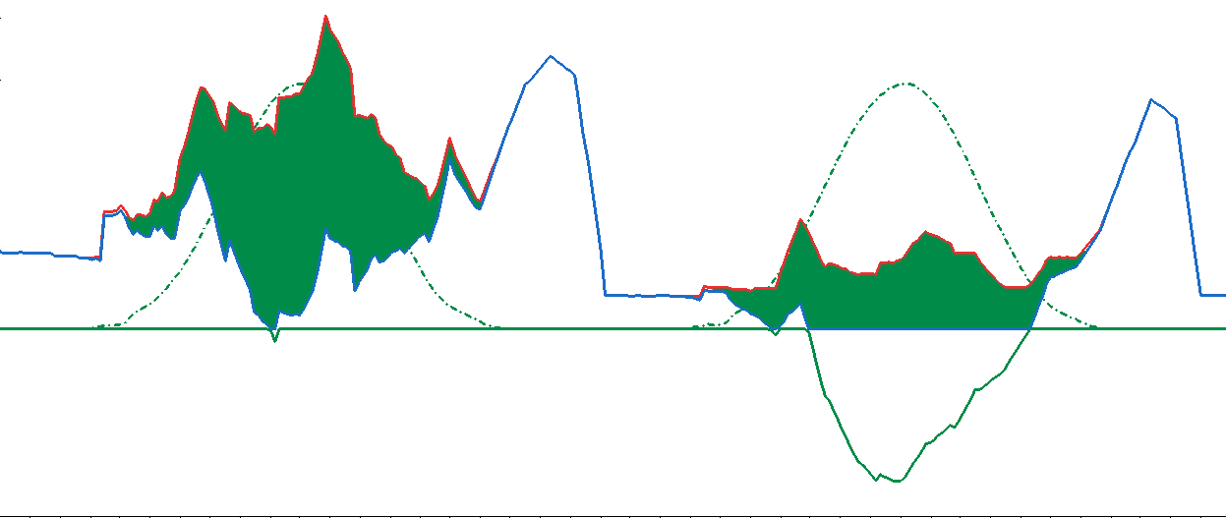
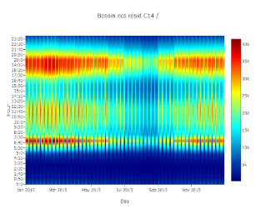
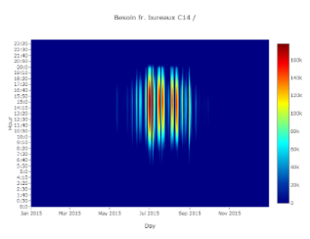
Give insights to the operational teams to secure real projects
Secure the project in terms of technical and financial risks → high competitive propositions
Socio-demographic context, constraints, opportunities, urban integration, sizing
Building geometry, shape, materials, … → optimized architecture
Energy use as in operation
Certification evaluation
Electricity demand
Self-consumption
PV production
54 €/MWh
Heating
DHW
Noon
Electric grid demand
Electricity surplus
Cooling
24 hous (Friday, 04/06)
24 hours(Saturday, 05/06)

